Slide 1
DINING HALL SUBSHIFT MANAGEMENT SYSTEM
BASTIN BAJIYO JOB
IST659

Slide 2
Overview
To create a database solution for the subshift management at dining halls
Prevent shift theft and implement a failproof management system.
Employees can substitute their shifts into a database.
Others can take this shift up – deleted once taken up
No room for foul play/ discrepancies

Slide 3
Project Procedure
A well structured database was created with all relevant details of dining halls, employers, student employees and schedules.
Rather than focusing too much on one utility, this project was done with concrete base tables and data, which is useful to build other applications as well.
A total to 7 tables of appropriate data entities were used
The data base was finally tied to an interactive application which can be directly used by the employees

Slide 4
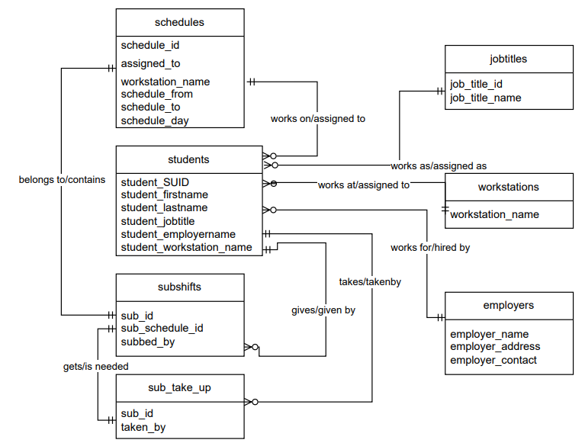
Conceptual Model

Slide 5
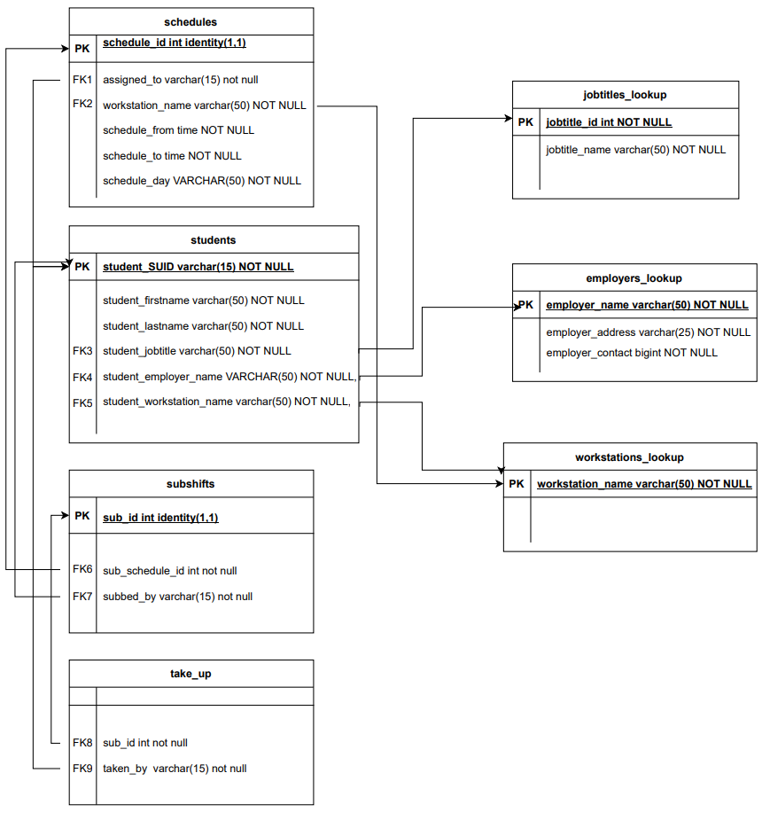
Logical Model

Slide 6
Basic Layout of application Screens
[A form screen where an employee can substitute their shifts]
Screen 1 : Sub out
Home Screen
Success Screen
Screen 2 : Available Sub Shifts
[ shows the current available list of sub shifts to be taken]

Slide 7
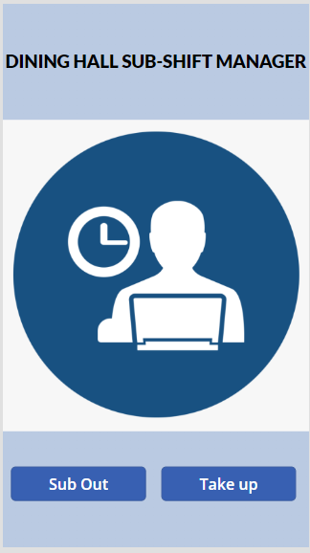
Actual application screens
Home Screen

Slide 8
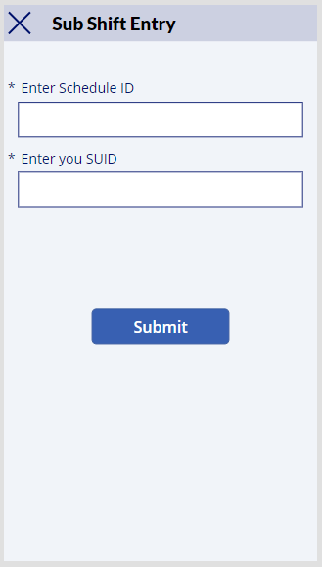
Actual application screens
Screen 1: Subout

Slide 9
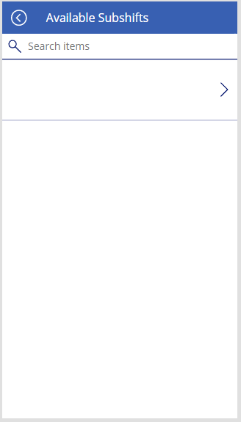
Actual application screens
Screen2: Available sub shifts

Slide 10
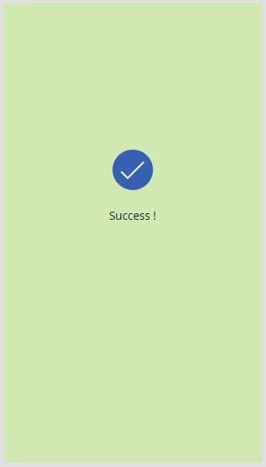
Actual application screens
Success Screen

Slide 11
Thank You !

